Slide 1
Opioid Addiction
Stephen Tamang, MD
3/14/20

Slide 2
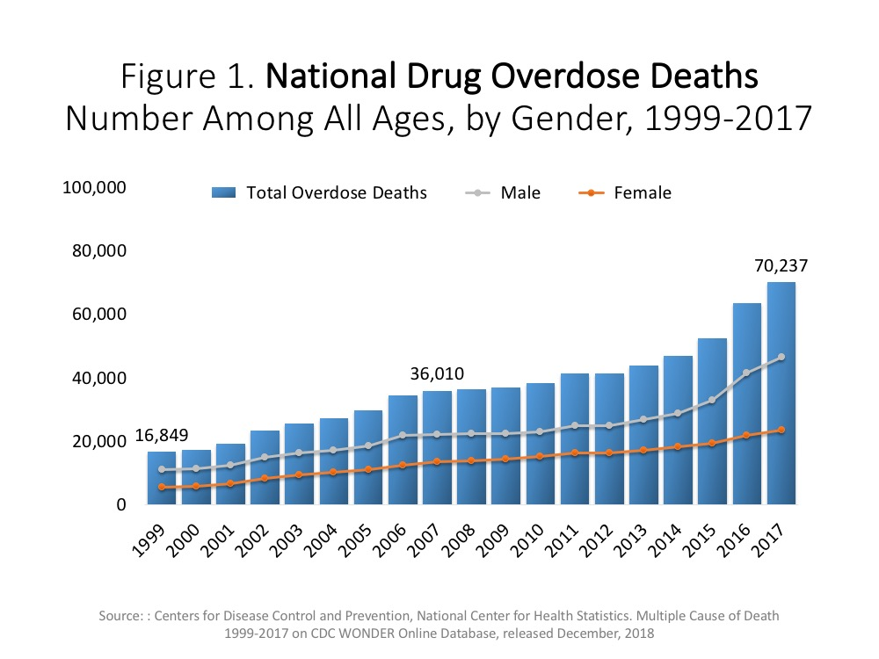
Key Statistics
Notes:
40,610 breast cancer
50,000 suicides
60,000 colon cancer

Slide 3
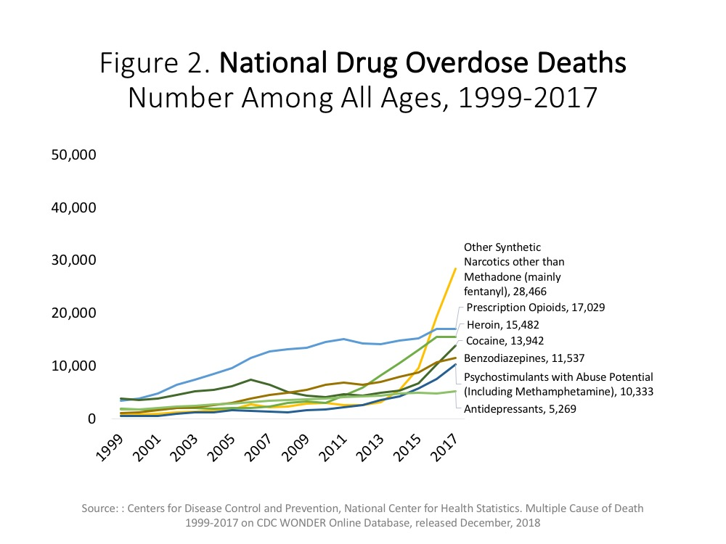
Key Statistics

Slide 4
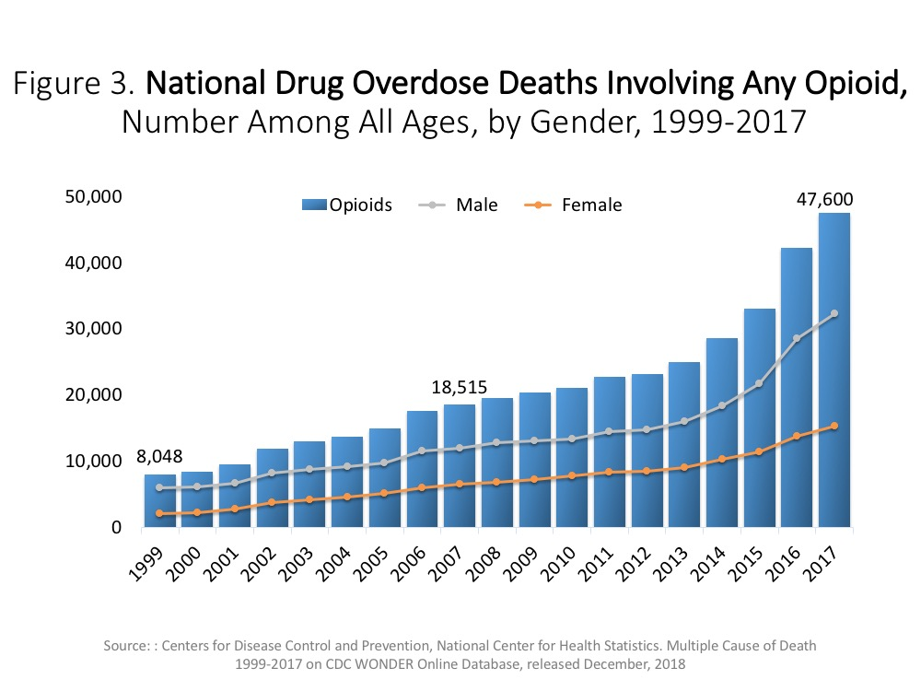
Key Statistics

Slide 5
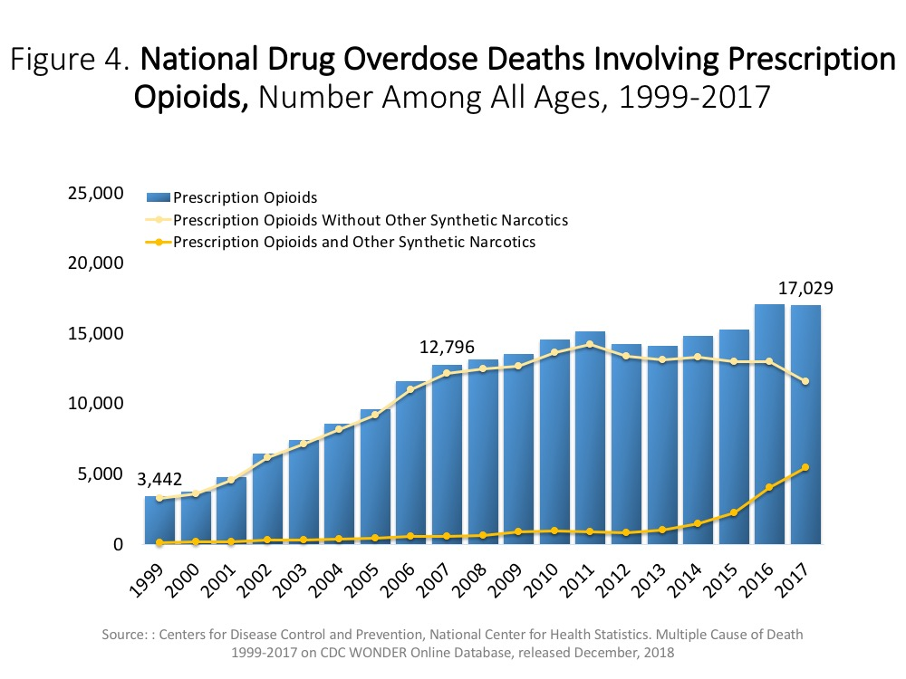
Key Statistics

Slide 6
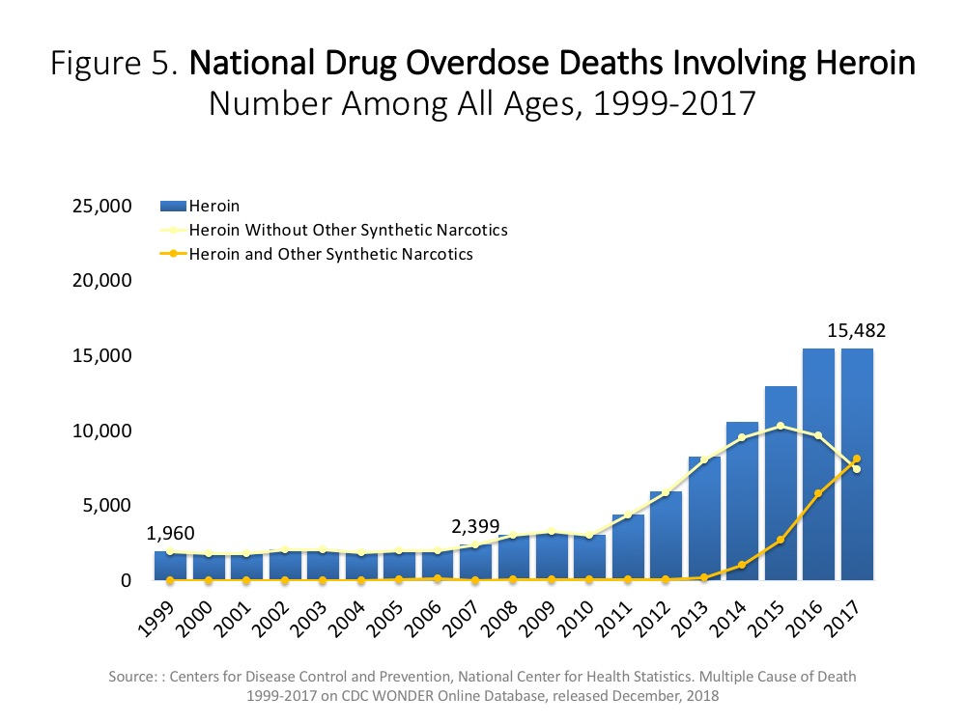
Key Statistics

Slide 7
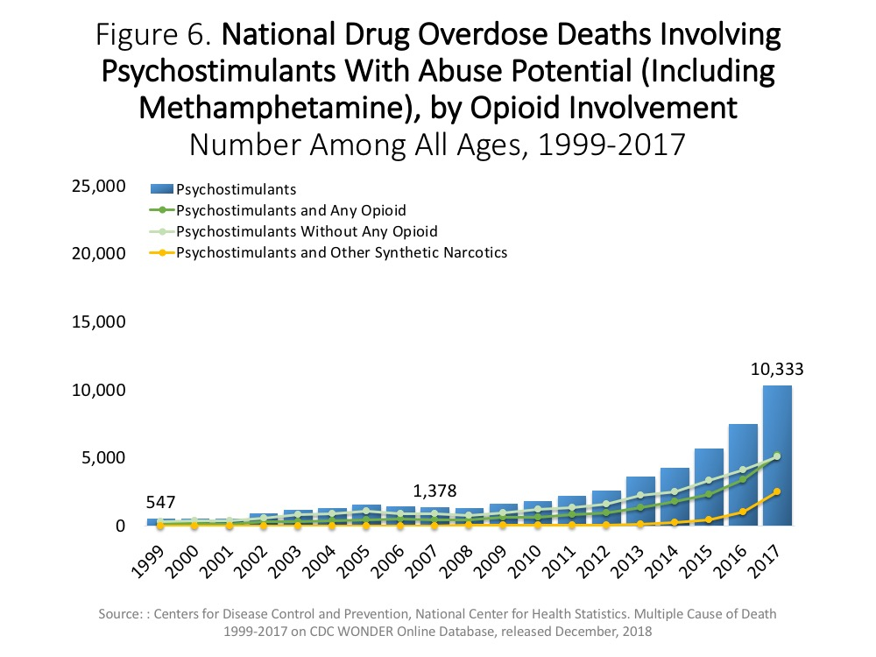
Key Statistics

Slide 8
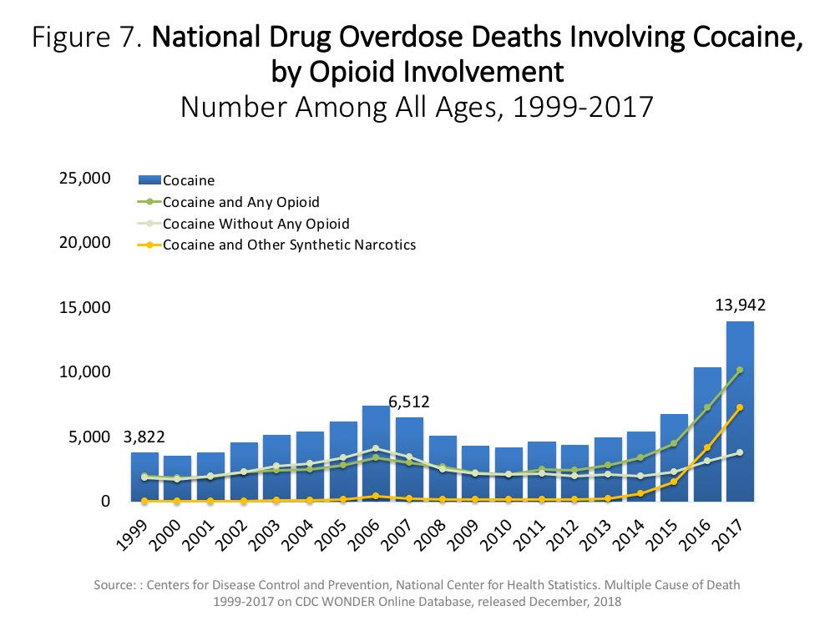
Key Statistics

Slide 9
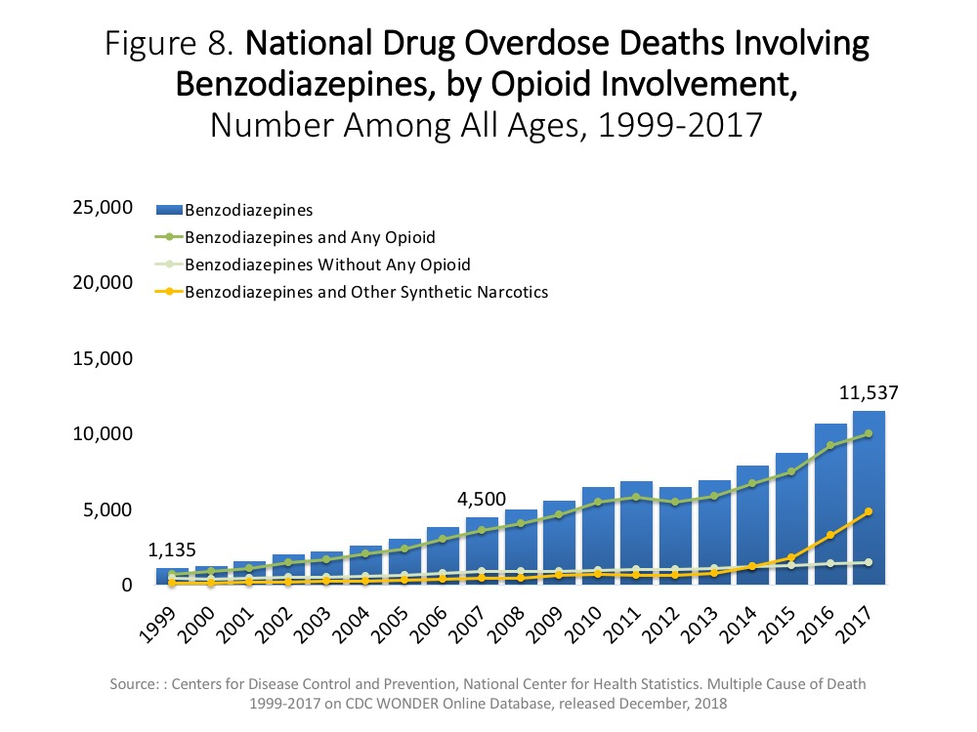
Key Statistics

Slide 10
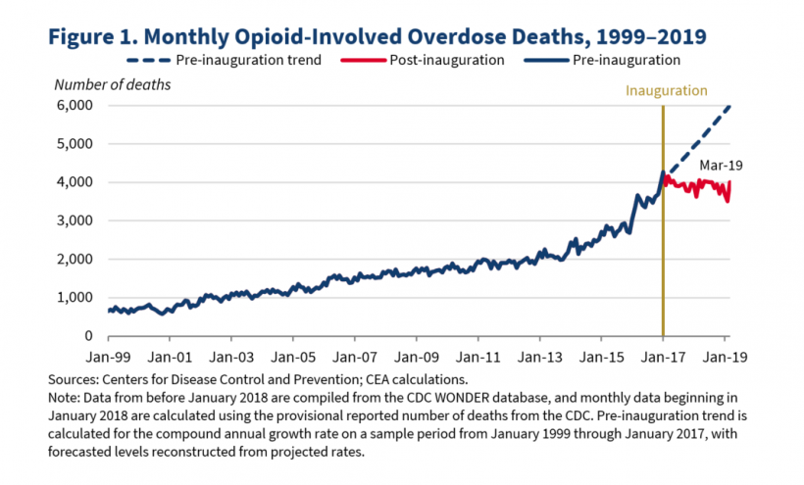
Key Statistics

Slide 11
Etiology
What caused the opioid epidemic?

Slide 12
Etiology
Pharmaceutical Companies
FDA Indications
Pain as a 5th VS (JCAHO-2001)
Notes:
Pharm research = reasonable research - wrong conclusions. Opioids help everything subjectively. Marijuana debate

Slide 13
Pharmaceutical Companies
Research
Peer reviewed
Reasonable in scope and scale
Wrong conclusions
Criminal Activity
Controlled Substance Act
Marketing to the contrary
The ‘Drug Rep’ Sales person

Slide 14
Pharmaceutical Companies
Federal Prosecutors opened CRIMINAL investigations under federal Controlled Substances Act
Companies are required to monitor commonly abused drugs disclosing suspicious pharmacy activity to the government.
Executives of a pharmaceutical distributor and the distributor itself are been charged with drug trafficking.

Slide 15
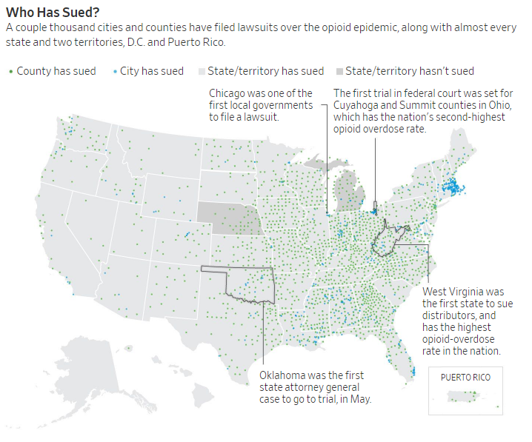

Slide 16
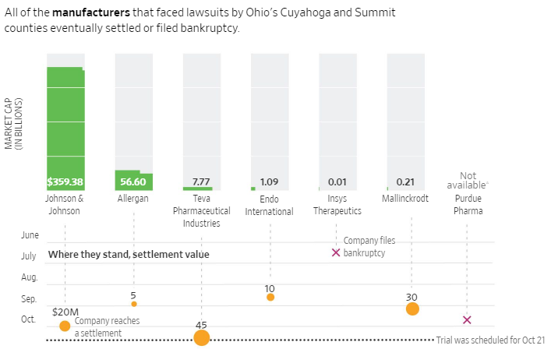

Slide 17
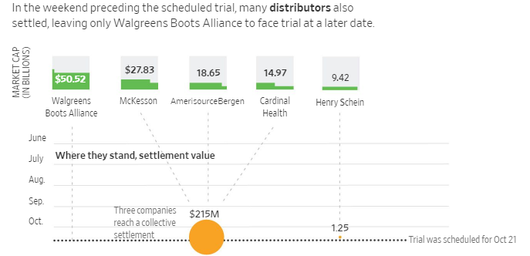

Slide 18
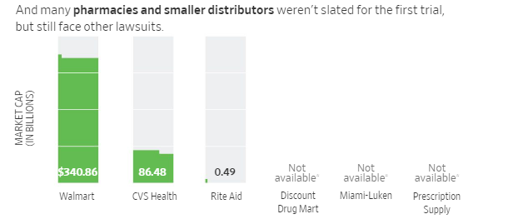

Slide 19
Etiology
Medical providers in the U.S. in 2015 prescribed enough opioids for every man, woman and child to get 128 Vicodin tabs!⁴⁸
Notes:
Pharm research = reasonable research - wrong conclusions. Opioids help everything subjectively. Marijuana debate

Slide 20
Pain as 5th VS
2001 - JCAHO introduced standards for organizations to improve their care for patients with pain, despite significant physician resistance, citing articles suggesting that addiction was rare when opioids were used for short-term pain.³
Notes:
Pharm research = reasonable research - wrong conclusions. Opioids help everything subjectively. Marijuana debate

Slide 21
Pain as 5th VS
2001 - JCAHO’s standards were based on the available evidence and the strong consensus opinions of experts in the field.
Notes:
Pharm research = reasonable research - wrong conclusions. Opioids help everything subjectively. Marijuana debate

Slide 22
Etiology
So ultimately it was strong misguided data, government approval, pressure to meet an arbitrary pain score, and possibly criminal distribution activity from pharmaceuticals companies that lead to the opioid epidemic.
Notes:
Pharm research = reasonable research - wrong conclusions. Opioids help everything subjectively. Marijuana debate

Slide 23
Definition
DSM5 - Opioid use disorder (OUD) is a chronic, relapsing disease.
Extremely low cure rates
Notes:
Pharm research = reasonable research - wrong conclusions. Opioids help everything subjectively. Marijuana debate

Slide 24
Definition
Disease vs character deficit debate
Notes:
Pharm research = reasonable research - wrong conclusions. Opioids help everything subjectively. Marijuana debate

Slide 25
Treatment
Guidelines blend between multiple disciplines
Evidence-based medicine was late in development
Notes:
Pharm research = reasonable research - wrong conclusions. Opioids help everything subjectively. Marijuana debate

Slide 26
Treatment
Detox?
Notes:
Pharm research = reasonable research - wrong conclusions. Opioids help everything subjectively. Marijuana debate

Slide 27
Treatment
“Relapse rate after opioid detoxification ranges from 72 to 88% after 12–36 months”
Notes:
Average stay of subjects for detoxification varied from two to four weeks depending on withdrawal signs and symptoms.
study in our tertiary care institute in India over two-year time period (1 Jan 2014 to 31 Dec 2015)

Slide 28
Treatment
Detox?
Counseling (intensive OP)?
Notes:
Pharm research = reasonable research - wrong conclusions. Opioids help everything subjectively. Marijuana debate

Slide 29
Treatment
“Despite detoxification combined with psychosocial treatment, relapse rates remain at 90% or higher”
Notes:
Multisite, randomized clinical trial using a 2-phase adaptive treatment research design.
Ten US sites. Patients A total of 653 treatment-seeking outpatients dependent on prescription opioids.

Slide 30
Notes:
During Phase 1, only 6.6% (43/653) of patients had successful outcomes, with no difference between the SMM and SMM+ODC. In contrast, 49.2% (177/360) attained successful outcomes in Phase 2 during extended buprenorphine-naloxone treatment (week 12), with no difference between counseling conditions. Success rates 8 weeks after completing the buprenorphine-naloxone taper (Phase 2, week 24) dropped sharply to 8.6% (31/360), again with no counseling difference. In secondary analyses, successful Phase 2 outcomes were far more common while taking buprenorphine-naloxone than 8 weeks post-taper (49.2% (177/360) vs. 8.6% (31/360), p<0.001). Chronic pain did not affect opioid use outcomes; a history of ever using heroin was associated with lower Phase 2 success rates while taking buprenorphine-naloxone.

Slide 31
Treatment
Detox?
Counseling (intensive OP)?
Medication Assisted Treatment
Notes:
Pharm research = reasonable research - wrong conclusions. Opioids help everything subjectively. Marijuana debate

Slide 32
What is Medication Assisted Treatment (MAT)?
Providing FDA-Approved medications for management of physical symptoms of SUD (OUD, AUD, NUD).

Slide 33
What is Medication Assisted Treatment (MAT)?
The Substances are on a continuum
IV Heroin > Heroin > PO Narcotics > Methadone > Buprenorphine > Sublocade > Vivitrol > Substance Free

Slide 34
What is Medication Assisted Treatment (MAT)?
The Substances are on a continuum
IV Heroin > Heroin > PO Narcotics > Methadone > Buprenorphine > Sublocade > Vivitrol > Substance Free
Harm Reduction

Slide 35
What is Medication Assisted Treatment (MAT)?
The medications are on a continuum
Insulin Pump or Drip > Insulin> Injectables > Multiple Oral Medications > Lone Oral Medication > Substance Free

Slide 36
MAT Double Standard
Diabetes
Complicated Disease vs character deficit
No Shame
No Blame
Great Access To Treatment
Opioid use disorder
Complicated Disease vs character deficit
Lots of Shame
Lots of Blame
Poor Access To Treatment

Slide 37
What is Medication Assisted Treatment (MAT)?
FDA has approved several different medications to treat opioid addiction and alcohol dependence
Methadone
Buprenorphine
Suboxone
Sublocade
Subutex
Naltrexone
Vivitrol

Slide 38
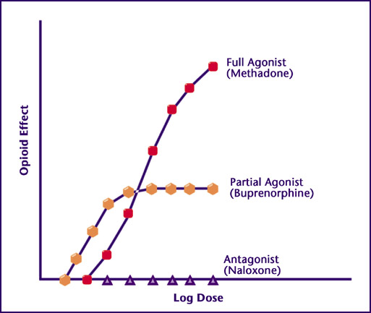

Slide 39
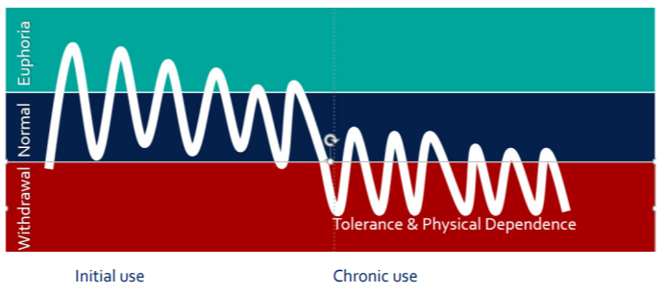

Slide 41
Evidence for MAT
Several placebo-controlled studies document the general efficacy of buprenorphine for OUD.
Lancet RPCT: randomized to buprenorphine had 1-year retention of 75% and negative urine drug tests in 75% of patients compared to 0% of patients randomized to placebo.²⁰

Slide 42
Evidence for MAT
Another major randomized placebo controlled trial by NEJM was terminated early because of the clear superiority of buprenorphine to placebo, with 4 times the rate of negative urine drug tests and significantly less craving in patients on buprenorphine.²¹

Slide 43
Evidence for MAT
In another study of 110 patients initiated on buprenorphine, those who remained on buprenorphine after 18 months were more likely to be sober, employed, and involved in 12-step groups.²²

Slide 44
Evidence for MAT
Buprenorphine significantly lowers the risk of mortality and adverse outcomes. In a metaanalysis, both methadone and buprenorphine maintenance were found to be superior to detoxification alone in terms of treatment retention, adverse outcomes, and relapse rates.⁶

Slide 45
MAT for pediatrics?
MAT in Adolescents • AAP Policy Statement: “Effective treatments, both medications and substance use disorder counseling, are available but underused, and access to developmentally appropriate treatment is severely restricted for adolescents and young adults.

Slide 46
Perspectives on MAT

Slide 47
Perspectives of MAT
Mayo Clinic 2010-2011
Southern Illinois University SOM 2011-2014
Opioid Perspectives (5th VS)
Drug Companies
FDA
Patient Preferences

Slide 48
Perspectives of Mat
Regional Health 2014 - current
“You will have the practice you deserve”
Proper Pain Management

Slide 49
Perspectives of Mat
Middle-aged patient with ankylosing spondylitis
New patient on high dose fentanyl and PO oxycodone
Guided reduction on dosing, counseling, frequent follow up
Multiple Family Meetings
Outcome

Slide 50
Government perspective on MAT

Slide 51
HHS.gov
What is the U.S. Opioid Epidemic?
“In the late 1990s, pharmaceutical companies reassured the medical community that patients would not become addicted to opioid pain relievers and healthcare providers began to prescribe them at greater rates.”

Slide 52
HHS.gov
What is the U.S. Opioid Epidemic?
“Increased prescription of opioid medications led to widespread misuse of both prescription and non-prescription opioids before it became clear that these medications could indeed be highly addictive.”

Slide 53
HHS.gov
What is the U.S. Opioid Epidemic?
“In 2017 HHS declared a public health emergency and announced a 5-Point Strategy To Combat the Opioid Crisis”

Slide 54
Consensus Guidelines on MAT

Slide 55
Perspectives of MAT
American Society of Addiction Medicine (ASAM)
American Academy of Addiction Psychiatry (AAAP)
American Academy of Family Physicians (AAFP)
US Department of Health and Human Services (HHS)
Substance Abuse and Mental Health Services Administration (SAMHSA)

Slide 56
Statistics:
90-100% Failure
50-90% Success

Slide 57
International Perspectives on MAT

Slide 58
Perspectives of Mat - International Success
Portugal’s Model
“Europe’s Heroin Capital”
Portugal was once Europe's worst country for drug misery and deaths. Now, it’s a public-health success story with a system that's been copied by its European neighbours.

Slide 59
Perspectives of Mat
In 1999, use of heroin, cocaine and other hard drugs was rampant. Approximately 100,000 Portuguese, or one per cent of the population, reported an addiction to hard drugs

Slide 60
Perspectives of Mat
Focus on decriminalization combined with harm reduction and rehabilitation programs transformed the society and has been studied by numerous countries

Slide 61
Perspectives of Mat
Europe’s drug-monitoring agency says Portugal’s mortality rate from drugs is now more than four times lower than the European average.
Decline in HIV and hepatitis infection rates, overdose deaths, drug-related crime and incarceration rates.

Slide 62
Perspectives of Mat
HIV infection plummeted from an all-time high in 2000 of 104.2 new cases per million to 4.2 cases per million in 2015.

Slide 63
Perspectives of Mat
The data behind these changes has been studied and cited as evidence by harm-reduction movements around the globe.
Serves as a model that is highly cited

Slide 64
Perspectives of Mat
One of Portugal's most important innovations has been its network of "dissuasion commissions."

Slide 65
Perspectives of Mat
Anyone caught with a “personal” amount of drugs — up to 10 days’ worth of a substance — can be ordered to appear before a health department official

Slide 66
Perspectives of Mat
Goal is to identify potential problem drug users early on and either provide them with information about treatment or quickly get them access to the health-care system.

Slide 67
Outreach Teams
In Portugal, every health district in the country has outreach teams that visit addicts every day and get to know their stories and needs.

Slide 68
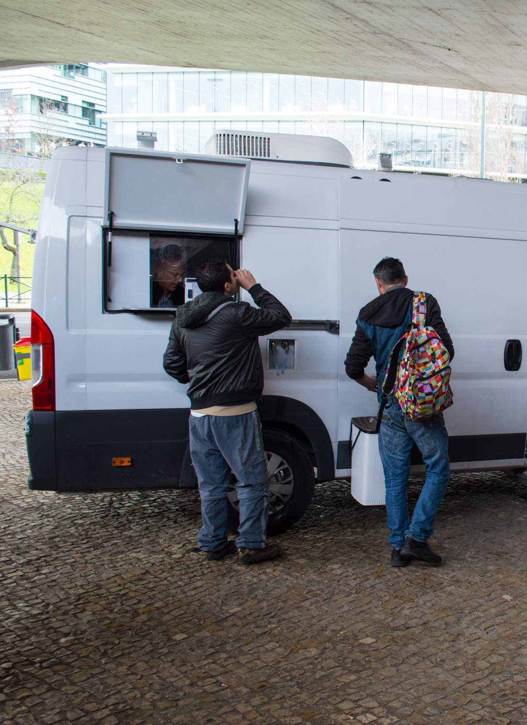
Outreach Teams
In Portugal, mobile methadone vans are common.

Slide 69
Prospective Summary
MAT is the gold standard for OUD from virtually all consensus guidelines and government interventional plans
MAT success is built around a systems-based approach
Harm Reduction and Decriminalization are principles worth considering

Slide 70
Solving the problem
Prevention
Treatment
Medication Assisted Treatment
Counseling / Mental Health
Harm Reduction
Peer Support
Enforcement

Slide 71
MAT Clinic
Evidence-based vs business models
Strange Laws: X-waivers
Arbitrary Patient limits
Intense tracking

Slide 72
Project Recovery is my best attempt at an evidence-based MAT clinic

Slide 73
MAT Clinic
Local support
ARC
Elevate Rapid City
Division of BH

Slide 74
ACCESS
Access without Liquid Handcuffs

Slide 75
MAT CLINIC VS MAT CLINIC
Good
No wait time
Free
No required services
Ancillary services offered (including ID)
System-based
Bad
Long wait times
Costly
Liquid Handcuffs
Limited ancillary support
Doc-in-Box

Slide 76
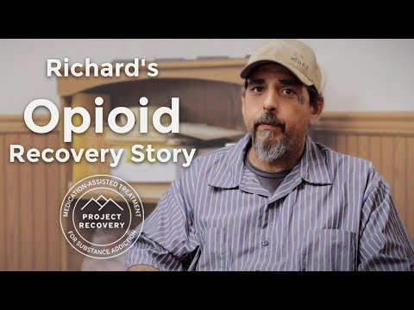
Standard Patient
Access
Hates being addicted
Ready to recovery

Slide 77
BEST MAT CLINIC CONCEPTS
SYSTEMS-BASED
EVIDENCE-BASED
ANCILLARY SERVICES

Slide 78
130 waivered providers in SD

Slide 79
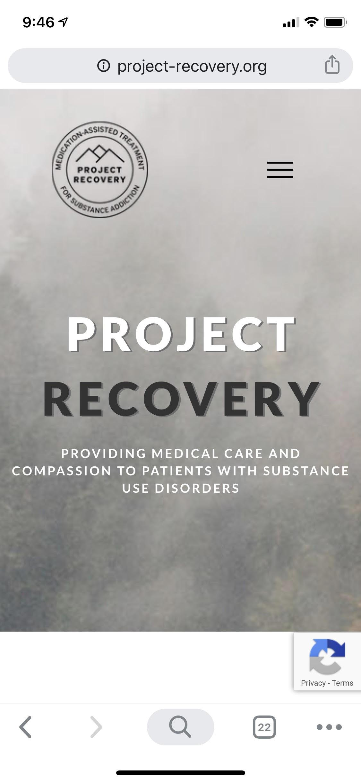
Mobile project
Place your screenshot here

Slide 80
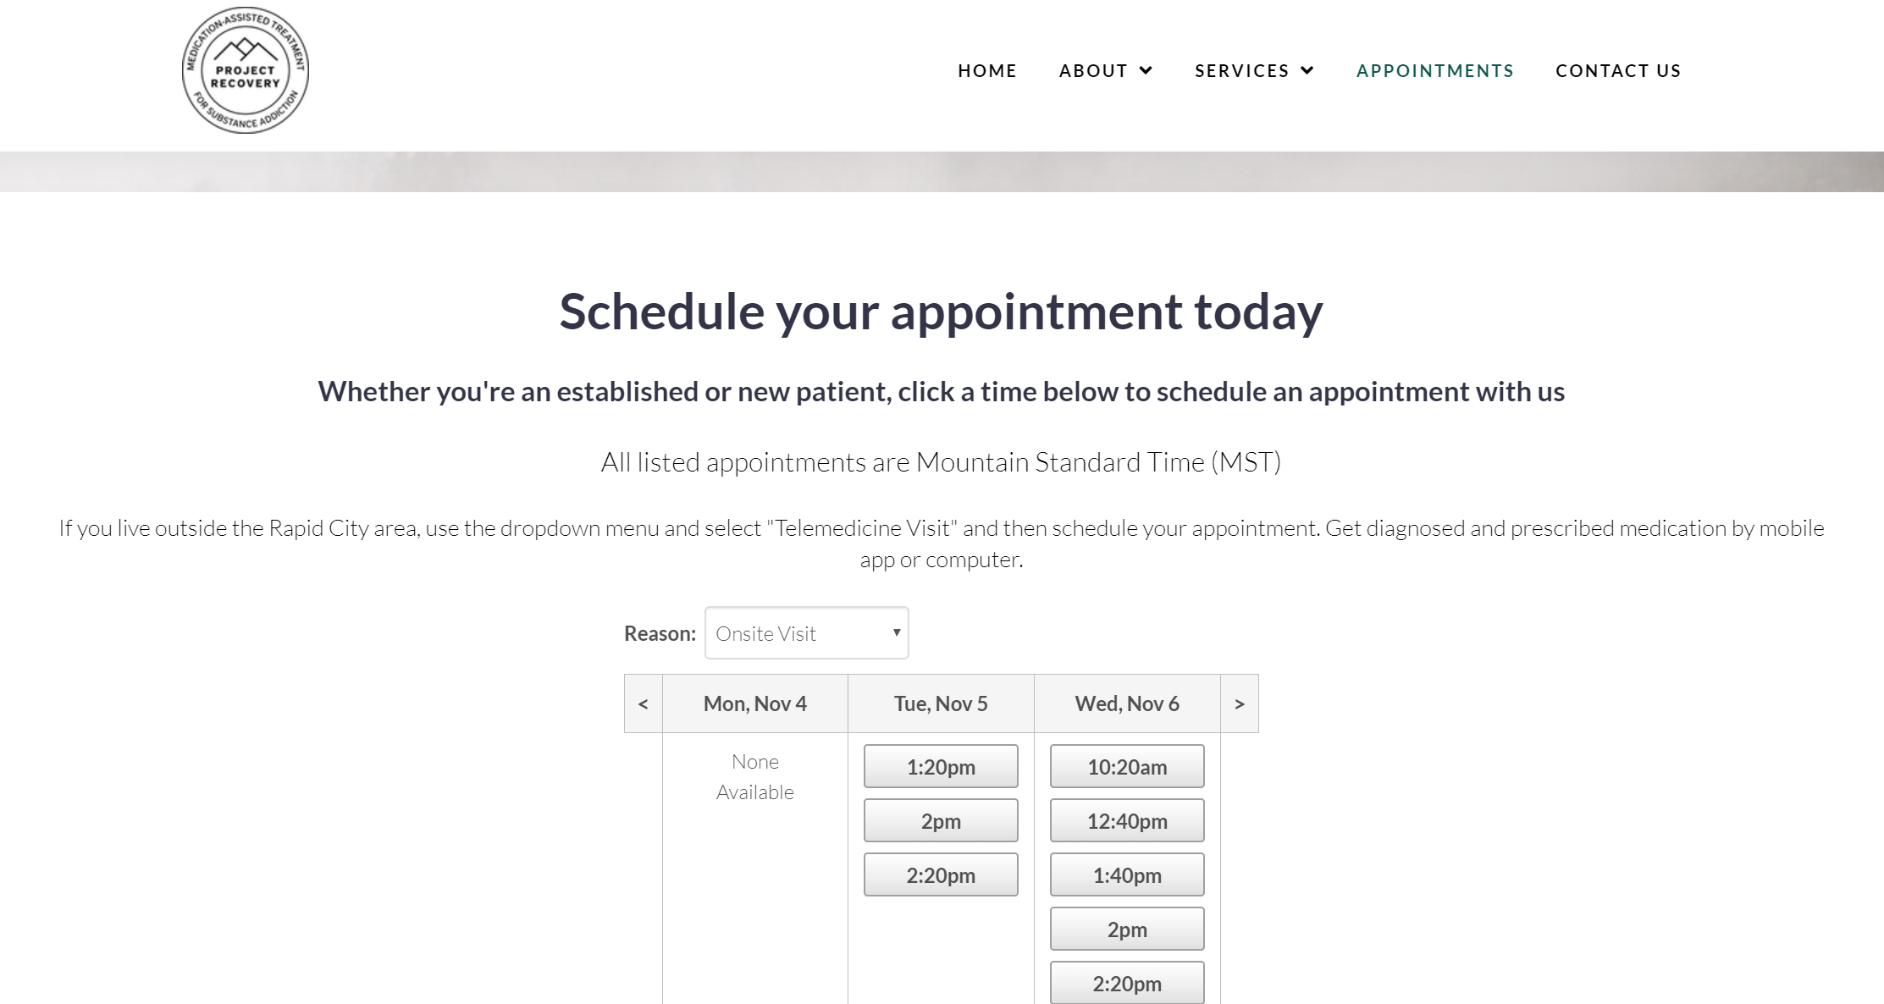
Desktop project
Place your screenshot here

Slide 81
Thanks!
Any questions?
You can find me at: stamang@monument.health
stephen902@gmail.com

